Slide 1
HTML
Hyper Text Markup Language
By: Asif Shahzad

Slide 2
What is HTML?
Hyper Text Markup Language
  Hyper Text means: Linked Text. One document is linked with other, user move from one page to another using links.
  Markup: Use of tags to markup text, images, etc. So HTML code are tags.
  Language means, there are certain rules or write those tags
We use .html OR .htm extension for web pages. .html is most common. None is required.

Slide 3
HTML Basic Tags Demo
Web Page Structure
  DOCTYPE declaration
  Html, head, body, h1 and p tags
Anatomy of HTML tag
  Start tag , end tag
  Tag text / content
  Tag Attribute
  Tag nesting
  Self Closing Tag or Empty tag (tag with no body)
  Rule: Close first what you opened last

Slide 4
Web Page, Tag and Attributes
Web browser parse the HTML code and renders the output on screen. HTML Code is set of tags, from a predefined list e.g. p, html, body … each tag is specific objective.
Tags may have attributes that specify additional information related to tag e.g. in below tag, the href attribute specifies hypertext reference of the link.
Tags may be nested inside other tags or may have content e.g. p. HTML documents are also called web pages.

Slide 5
HTML Tags … Continue
html, head, title, body
Paragraph and Headings
Lines and Line Breaks
Text Formatting
  b, i, sub, sup, pre
  cite, abbr, address, q (explore using in lab)
Comments
  <!-- comment text here -->
Notes:
Demonstrate each tag writing code. Also explain tag attributes: class, id, style, title,

Slide 6
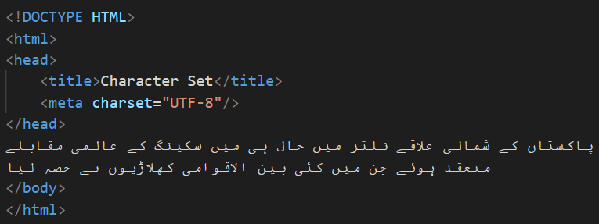
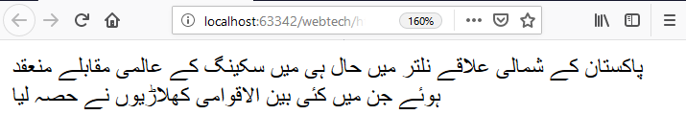
Meta Tags
Page Character Encoding

Slide 7
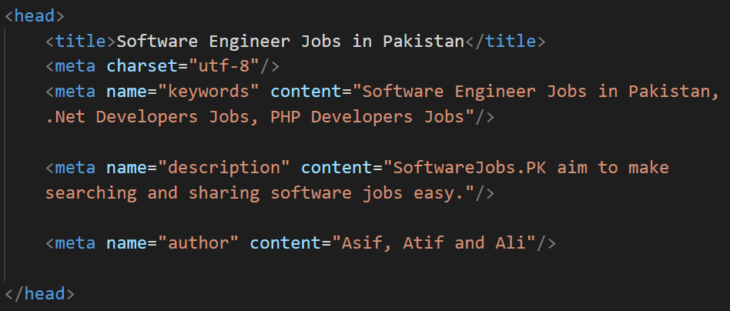


Meta Tag - description

Slide 8

Meta Tag – Open Graph

Slide 9
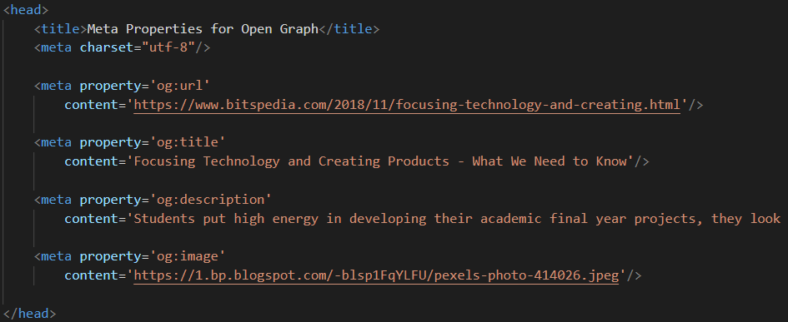
Social Sites Use Meta Tag for URL, Title, Description and Image

Slide 10
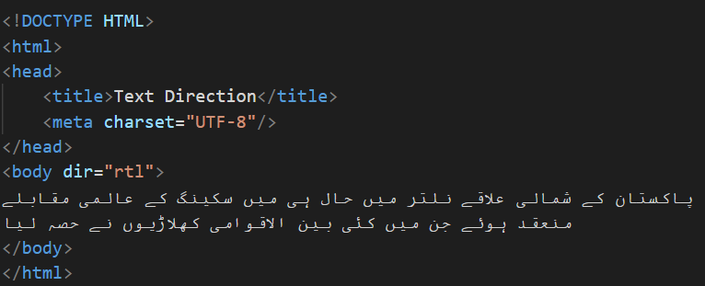
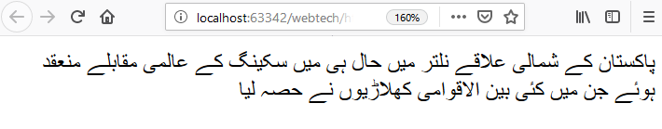
dir (Direction) Attribute

Slide 11
Link
Link makes the web, web i.e. it connect one page to another. Link help to navigate user from one page to another page with same domain or other domains.
Lets create a Hyperlink. Demo.
  ‘a’ is taken from Anchor, means link
  ‘href’ stands for Hypertext Reference | it’s the link target
  Content user see is called Anchor Text or Link Text.
  target attribute, often used for external links
  Use ‘title’ attribute for screen readers. Or tip where the link direct.
Relative Vs Absolute URL. Relative URL to link other pages of same web application. Absolute for external links.
To add links to another part of the same page, fragment identifiers or anchor tag name attribute is used.
Anchor text should be concise, relevant and informative. Anchor text and titles are used in SEO ranking, so do keyword research to use right content.
Notes:
Html content models?

Slide 12
Img tag
How to insert an image in a web page
src attribute, relative path, internal and external images
How to make an image, a link
Width and height property
  On slow connection, unspecified height/width leads to bad UX. Simulate such connection in Chrome DevTools. Layout Shift. Images loads in parallel
  Single image for icon, thumbnail, and normal size VS multiple images
  Take care of Aspect Ratio and keep Dot Per Inch (DPI) low
Blocking URL or domain e.g. image-not-found issue check
The alt attribute: Good for SEO and screen readers
Single image VS multiple images … srcset attribute
Specifying image in multiple formats using picture and source tags

Slide 13
Forms
Forms are used to get input from user
  Input text field, password field
  Label ‘for’ attribute
  radio and checkbox input fields
  Drop down list … select and option tags
  Hidden input field
  Textarea and its rows and cols attributes
  Button types: submit, reset, button
  Using button as input field
  HTML 5 input types: url, date, and email [practice in lab]

Slide 14
Forms
Form Attributes
  action
  method
Difference between GET and POST
Making already filled form (or update form)
  User Experience (UX) Tip: Never ask to update a property without showing current value of that, except password.

Slide 15
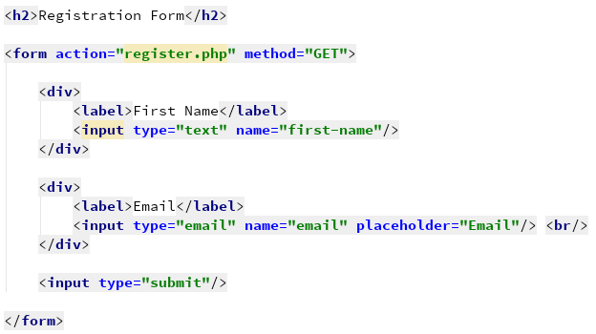
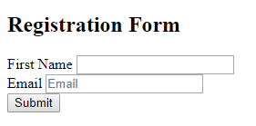

Slide 16
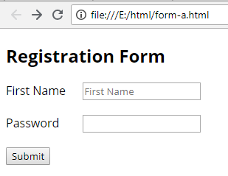
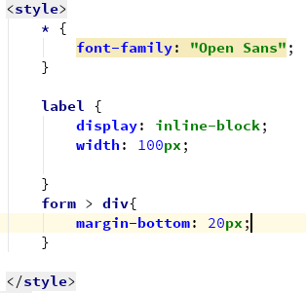
Styling Forms

Slide 17
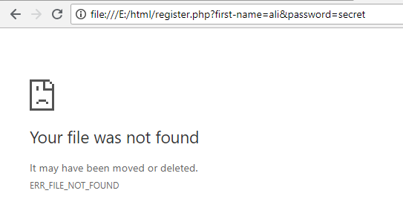
Submit the Form

Slide 18
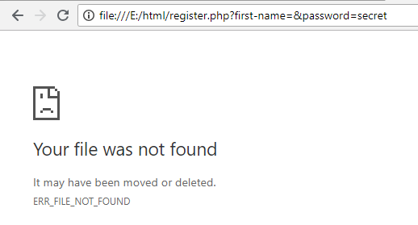
Submit with Empty Value

Slide 19
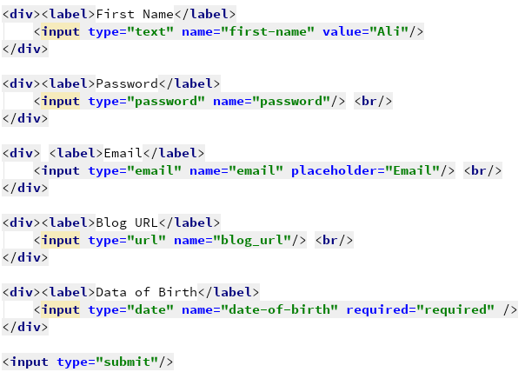
Value & Required Attribute
HTML 5 Input Types

Slide 20
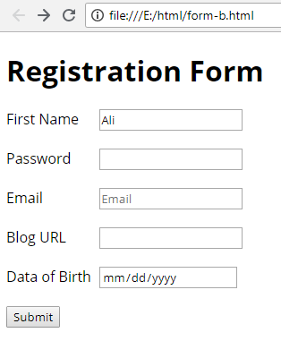
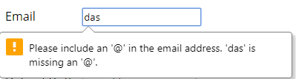

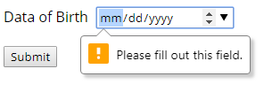
Form Output

Slide 21
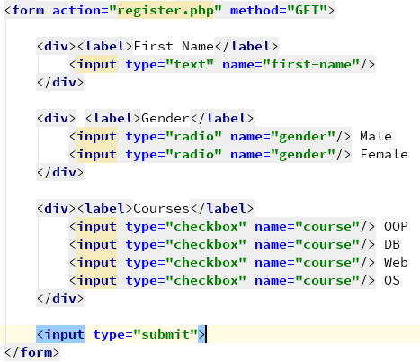
Radio and Checkbox fields

Slide 22
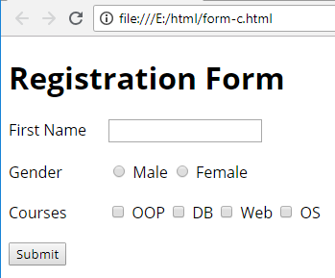
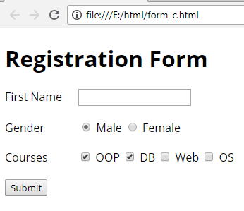
Form Output

Slide 23
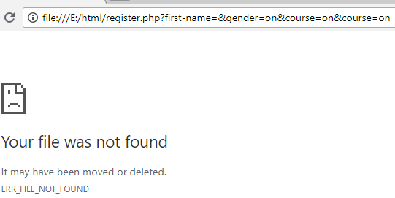
Radio & Checkbox Form Submitted

Slide 24
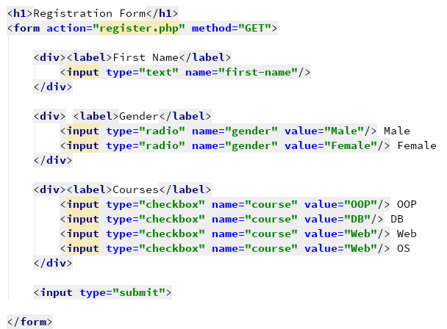
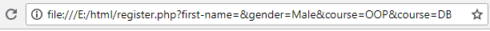
Form Submitted with Value Attr.

Slide 25
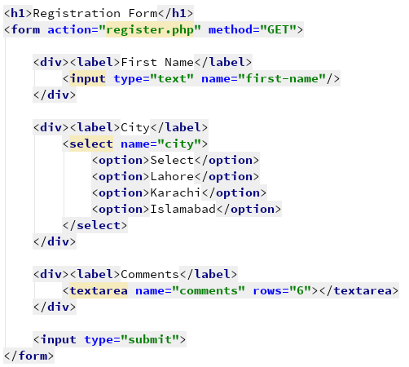
Option List and Text Area fields

Slide 26
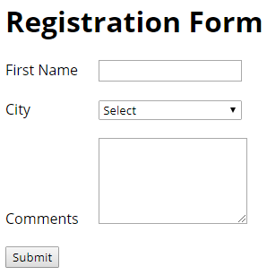
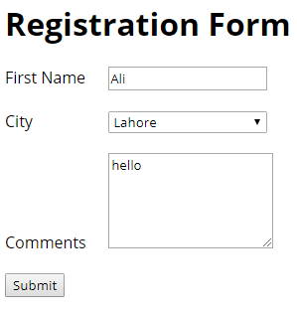
Option List and Text Area - Output

Slide 27
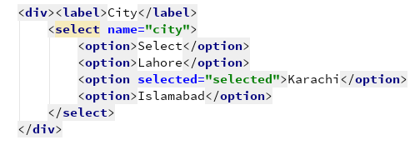

Pre-Selected Option

Slide 28
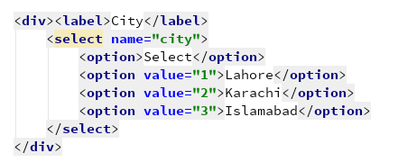
Options with Custom Value

Slide 29
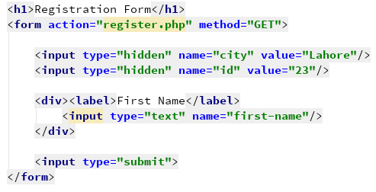
Hidden Input Field

Slide 30
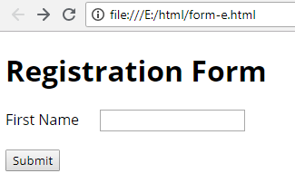
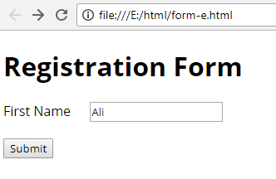
Hidden Input Field – Form Submit

Slide 31
Using Submit Button as Input Field
If we do not specify name of submit button, no value is sent to server.
If we specify name of submit button, ‘submit’ is sent as default value.
If there are multiple submit buttons, only the clicked buttons’ param-name and value is sent to server.

Slide 32
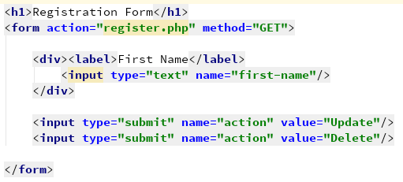
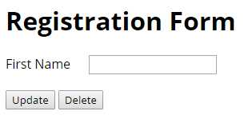
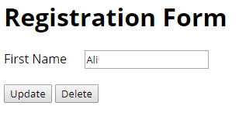
Submit Type Button as Input Field
Name is required, to use submit type as request parameter. Value is optional.
Notes:
If we do not specify name of submit type field, its not submitted to server. Though rest of data is sent to server.

Slide 33
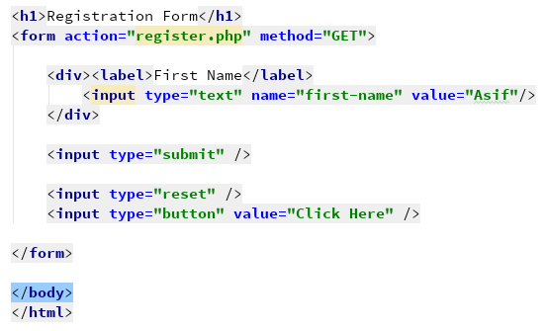
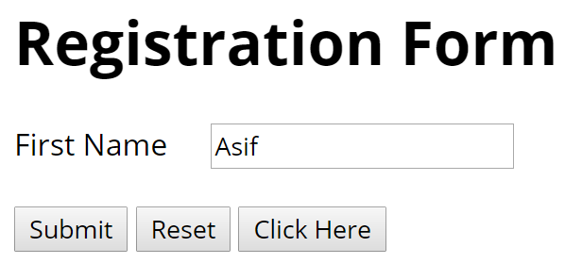
Reset Button & Standard Button

Slide 34
Tables and Lists
Table
  Table row, data
  Attributes: border, width
  Cells spanning multiple rows: rowspan
  Cells spanning multiple columns: colspan
  Making table: caption, head, body, footer
  caption, thead, tr, th, tbody, td, tfoot tags
Lists
  Ordered list (type:1,A,a,I,i)
  Unordered list (type: disc, circle, square, none)
  List Items

Slide 35
Block Elements
Basic info and default properties
  Occupy 100% of available width
  Auto shift subsequent elements in next row
    Examples: Headings, Paragraphs, div, ul, etc.
  Are sizeable e.g. width, height, etc.

Slide 36
Inline Elements
Inline: span, a
  Occupy space as per their contents
  Do not shift other elements in new line. Fit inside other contents e.g. span in p or div
  We can’t apply width, height properties on inline elements (unless we change them to block, or … )

Slide 37
HTML5 Semantic Tags
div and span tag – non semantic
Using semantic tag is good practice from SEO perspective. We are clearly representing what our container carry inside it.
Some HTML 5 Semantic Tags:
  header
  nav
  main, section, article
  aside
  footer

Slide 38
HTML Head Tag
Contains information about page, external attached documents, icons, styles, scripts, etc.
Different tags are used to describe such info:
  Meta – Different type of info. about the web page.
  Title – Page title
  Style – Define styling
  Link – Link external CSS file
  Script – Link external JS or write JS code
Notes:
Meta: author, revised, description, keywords, http-equiv. link:rel, type, href

Slide 39
Structured Data (Skip this. We would see in SEO Lecture)
In addition to basic on-page SEO strategies. We can further improve our website SEO by incorporating structured data. The Structured Data term is used to further annotate a webpage using standard vocabularies that search engines understand. It help machines e.g. search engines, to precisely understand our webpage.
Common standards to provide structured data about our webpage includes: JSON-LD, MicroData and RDFa. Google Recommend using JSON-LD. JSON-LD and MicroData, both make use of common vocabulary published at schema.org.
Visit https://developers.google.com/search/docs/guides/intro-structured-data to get basic understanding how we can use JSON-LD.
Visit https://www.tutorialspoint.com/html5/html5_microdata.htm to get basic understanding how MicroData is used. Here is the reference docs: https://www.w3.org/TR/microdata/

Slide 40
Practice Task
Explore iframe, video and audio tags to embed different type of contents. Must explore different attributes of these tags in detail.
  Table, thead, tr, th, td
  "Iframes in detail" section from http://t.ly/Od0Gl
  Audio and video tags. Visit http://t.ly/NZEdW
  ol, ul, li etc.
  cite, abbr, address, q (explore using in lab)
Make code samples using these tags. The code samples must illustrate the usage of different attributes of these tags.

